Slide 1


Airbnb Dashboard
By: Ahmed Bedair

Slide 2
Intro
Airbnb, Inc is an American company that operates an online marketplace for lodging, primarily homestays for vacation rentals, and tourism activities. Based in San Francisco, California, the platform is accessible via website and mobile app. Airbnb does not own any of the listed properties; instead, it profits by receiving commission from each booking. The company was founded in 2008. Airbnb is a shortened version of its original name, AirBedandBreakfast.com.
Since 2008, guests and hosts have used Airbnb to travel in a more unique, personalized way. As part of the Airbnb Inside initiative, this dataset describes the listing activity of homestays in New York City.

Slide 3
Project KPIS
Identifying relationships between Neighborhoods pricing and rating
Identifying relationships between room types pricing and rating

Slide 4
Steps Before Dashboarding
Before We made our Dashboard to visualize our data we’ve made some steps to make our data ready for dashboarding stage :
Importing and Exploration
Dropping unnecessary columns
Imputing and removing nulls
Making Basic visualizations before dashboarding

Slide 5

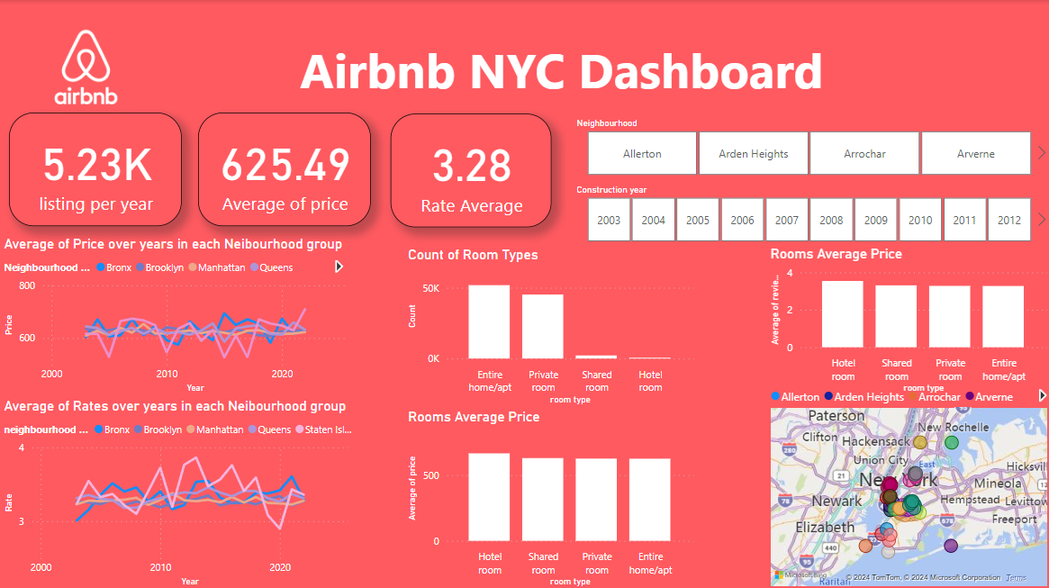
Full Dashboard

Slide 6
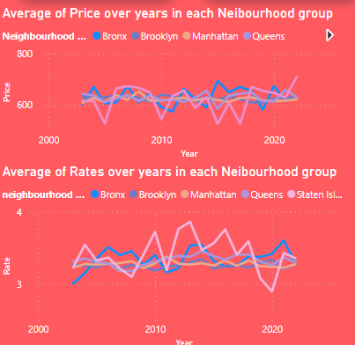
Prices and Rates vs Years
We found here that in the most of neighborhoods Pricing is very related with rating that when the price of night rises the rating decreases

Slide 7
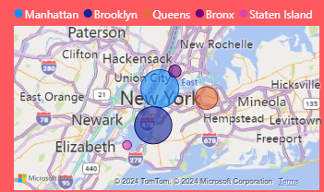
Neighborhood Group Distribution
In my opinion the count of rooms in each neighborhood plays a big role in pricing and rating way we found that Staten island is the best place in New York for booking even it has the least number of rooms

Slide 8
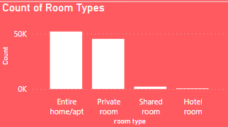
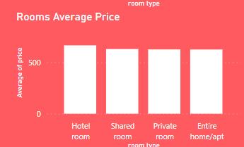
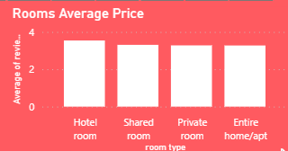
Room types vs pricing and rating
We found here that the room types price doesn’t affect the count but we notice that even if they aren’t many hotel rooms compared to other types we found that their price and rating are high so the rooms count affects the prices and rating

Slide 9
Overall Summary
Relation between pricing and rating are opposite
Relation between rooms counting and rating are positive

Slide 10
Resources
Dashboard Link :
https://app.powerbi.com/groups/me/reports/d5a9c326-9d55-4e0c-8807-a7c01a37bad5/ReportSection?experience=power-bi
Dataset Link : https://www.kaggle.com/datasets/arianazmoudeh/airbnbopendata

Slide 11
Thank You

